Slide 1

Survival Analysis: Models for Time to Event Data
Steve Simon
Workshop Instructor

Slide 2
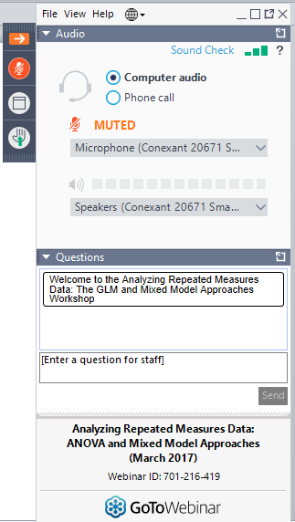
GoTo Webinar

Slide 3

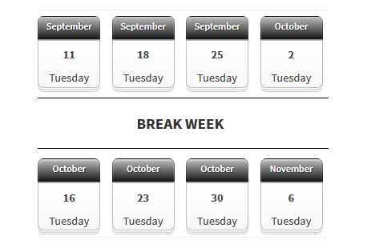
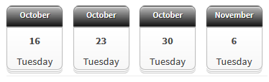
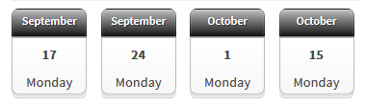
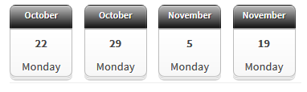
Workshop Schedule
Training webinars: Tuesdays, from 12 – 2pm (Eastern)
Q&A sessions: Mondays 12 – 1pm (Eastern)

Slide 4
The Mechanics of the Workshop: The lectures
Eight modules, 1 ½ to 2 hours long, with a one week break after week 4.
Participants can attend live lectures and/or watch taped lectures.
All participants will be able to download a pdf copy of the slides the day of the presentation.

Slide 5
The Mechanics of the Workshop: Live attendance
If attending the lecture live:
Attendees are muted to reduce background noise.
Attendees can ask questions during the presentation by typing into the comment box.
Only the instructor can see the questions.
The questions will be read out loud so those in attendance and those watching the recordings will know the question. The name of the person asking the question is not named.
Instructor will stop at the end of each section to answer the questions. At times, the questions will be answered when submitted.

Slide 6
The Mechanics of the Workshop: After the lecture
At the end of the lecture the syntax/code to repeat everything shown in the lecture will be available in R.
There will be videos explaining how to use the menu bars when discussing a new topic when appropriate (some software require more menu explanation than others). The videos will also explain how the syntax/codes are used and all special options used.
Participants can download the syntax/code.

Slide 7
The Mechanics of the Workshop: Exercises
Exercises will be available after the lecture to practice the concepts taught during the lecture.
Answers and the syntax/code to answer the questions will be available at the same time.
You can download the answers and syntax/code to all four software packages if you want.

Slide 8
The Mechanics of the Workshop: Asking questions at any time
All participants (live and those watching the recordings) will be able to write in questions through a forum. The goal is to answer all questions within 24 hours.
All participants will be able to read and learn from other participants’ questions.
Everyone can ask questions on the forum for up to a year.
https://programs.theanalysisfactor.com/forums/

Slide 9
The Mechanics of the Workshop: Q&A sessions
There are eight one hour weekly Q&A’s.
If you are unable to attend the Q&A live, you can send in your questions in advance and have them answered during the live Q&A.
We will answer any software specific questions for all four software packages.
The Q&A sessions are recorded and will be available for viewing within 24 hours.

Slide 10
The Mechanics of the Workshop: Additional Resources
Specific topic videos.
Probability Rules and Applications (1:34:32)
13 Steps to Running any Statistical Model (58:06)
Discrete Time Event History Analysis (01:26:54)
A Primer on Exponents & Logarithms for the Data Analyst (01:43:46)

Slide 11
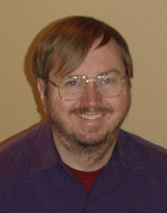
The Instructor
Steve Simon, PhD

Slide 12
Workshop Outline
Module 1: The Kaplan-Meier Curve
Constructing a Kaplan-Meier Curve
Censoring and Its Assumptions
Log Rank Test for Subgroup Comparisons

Slide 13
Workshop Outline
Module 2: The Hazard Function and the Cox Proportional Hazards Model
Definition of a Hazard Function
Constant Hazard vs Increasing or Decreasing Hazard
Steps to Run Cox Regression Models and Interpret Model Coefficients

Slide 14
Workshop Outline
Module 3: Planning and Data Management Issues
Data Set Up for Survival Analysis
Compute and Compare Power
Problems with Date Variables

Slide 15
Workshop Outline
Module 4: Cox Model: Model Fitting and Diagnostics for the Cox Model
Multiple Predictor Variables
Risk Adjustment
Proportional Hazards

Slide 16
Workshop Outline
Module 5: Parametric Models
Comparing Hazard Functions for Popular Distributions
Interpreting Coefficients
Understanding Advantages and Disadvantages

Slide 17
Workshop Outline
Module 6: Time-Varying Covariates in a Cox Model
How to Code Data for Time-Varying Covariates
Fit Time-Varying Models
Interpreting the Results

Slide 18
Workshop Outline
Module 7: Frailty Models
Multiple Events per Patient
How to Define Random Effects
How to Fit and Interpret the Models

Slide 19
Workshop Outline
Module 8: Competing Risk Models
Multiple Events per Patient

Slide 20
Questions?

